Slide 1


thÉireP || ePrescriptions - Solution Architecture
HTTP | CRUD
Post | Create
Get | Read
Put | Update
Delete | Delete
JSON Registration & Authentication Flows
& Prescriptions CRUD
Node Application
React Application
Component
State
Property
Action
Reducer
Windows
MongoDB
Requests
Web Server
Responses
JSON
Collections:
Surgeries
Pharmacies
Prescriptions
Responses
REST APIs
JSON
Requests
User Directory
(GPs & Pharmacies)

Slide 2
thÉireP || ePrescriptions – Backend Data Schemas
Doctor Schema IMCN:{ type: Number, required: true, }, DocEmail:{ type: String, required: true, }, DocPassword:{ type: String, required: true }, DocPasswordConf:{ type: String, required: true }, DocName:{ type: String, required: true }, DocPhone:{ type: Number, required: true, }, DocAddress:{ type: String, required: true }, avatar:{ type: String, }, Date:{ type: Date, default: Date.now }, });
const PharmacySchema = new mongoose.Schema({ PSIN:{ type: Number, required: true, }, PharmaEmail:{ type: String, required: true, }, PharmaPassword:{ type: String, required: true }, PharmaPasswordConf:{ type: String, required: true }, PharmaName:{ type: String, required: true }, PharmaPhone:{ type: Number, required: true, }, PharmaAddress:{ type: String, required: true }, avatar:{ type: String, }, Date:{ type: Date, default: Date.now }, });
PPSN:{ type: String, required: true, }, patientName :{ type: String, required: true, }, presFreQ:{ type: Number, required: true }, prescContents:{ type: String, required: true }, prescDosageMG:{ type: Number, required: true }, prescribedDate:{ type: Date, required: true, default: Date.now }, dispensedDate:{ type: Date, default: Date.now // similar to like button? }, isDue:{ type: Boolean, }, });

Slide 3
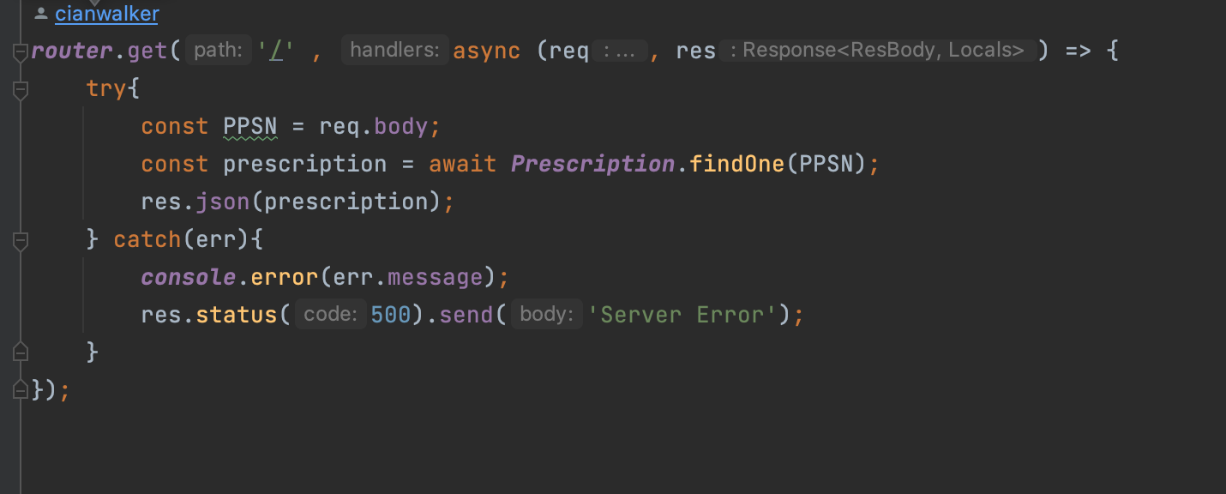
thÉireP || ePrescriptions - Backend APIs samples.
router.post('/', [ check('PPSN', 'Please Enter a valid PPS Number').not().isEmpty() , check('patientName', 'Please Enter an Patient Name').not().isEmpty(), check('presFreQ', 'Please enter a prescription frequency in days').isNumeric().not().isEmpty(), check('prescContents', 'Please specify prescription contents').not().isEmpty(), check('prescDosageMG', 'Please specify prescription dosage').not().isEmpty()], async (req, res) => { const errors = validationResult(req); if(!errors.isEmpty()){ return res.status(400).json({errors: errors.array()}); } console.log(req.body); const {PPSN, patientName, presFreQ, prescContents, prescDosageMG} = req.body; try{ prescription = new Prescription({ PPSN, patientName, presFreQ, prescContents, prescDosageMG }); await prescription.save() res.send('Prescription Submitted Successfully'); } catch(err){ console.error(err.message); res.status(500).send("Server Error"); } });
MongoDB
Collections:
Surgeries
Pharmacies
Prescriptions
User Directory
(GPs & Pharmacies)

Slide 4
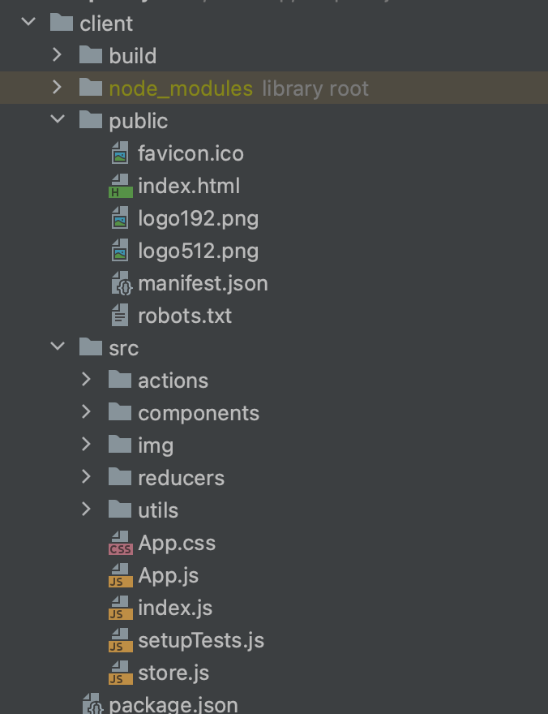
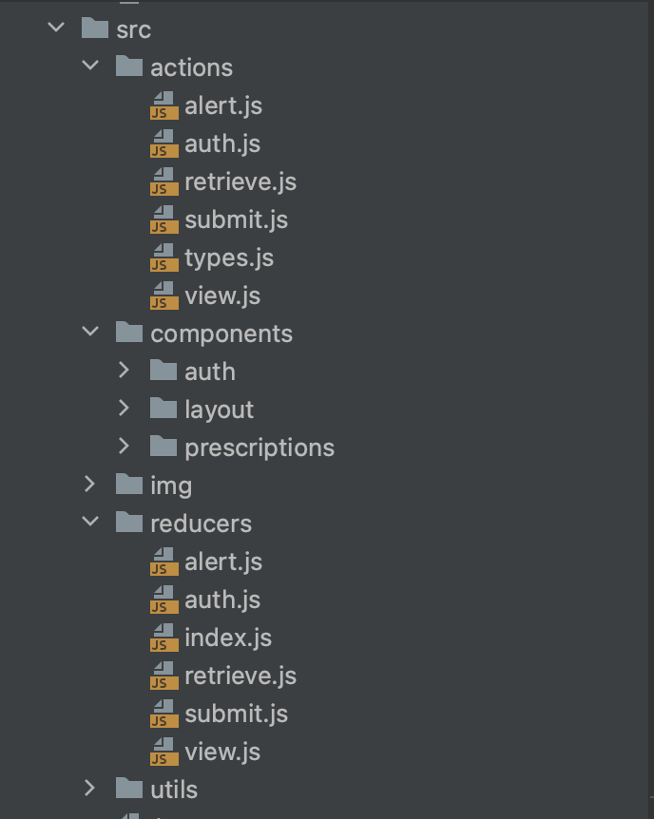
thÉireP || ePrescriptions- Frontend React Structure
MongoDB
Collections:
Surgeries
Pharmacies
Prescriptions
User Directory
(GPs & Pharmacies)

Slide 5
thÉireP || ePrescriptions- Frontend React Reducers Sample
function authReducer(state = initialState, action) { const { type, payload } = action; // export default function(state = initialState, action){ // const {type, payload} = action; switch (type){ case USER_LOADED: return{ ...state, isAuthenticated: true, loading: false, user: payload } case REGISTER_SUCCESS: case LOGIN_SUCCESS: case GOOGLE_AUTH: localStorage.setItem('token', payload.token); return{ ...state, ...payload, isAuthenticated: true, loading: false } case REGISTER_FAIL: case AUTH_ERROR: case LOGIN_FAIL: case LOGOUT: localStorage.removeItem('token'); return{ ...state, token: null, isAuthenticated: false, loading: false } default: return state; } } export default authReducer;
import { REGISTER_SUCCESS, REGISTER_FAIL, USER_LOADED, AUTH_ERROR, LOGIN_SUCCESS, GOOGLE_AUTH, LOGIN_FAIL, LOGOUT } from "../actions/types"; const initialState = { token: localStorage.getItem('token'), isAuthenticated: null, loading: true, user: null, }
MongoDB
User Directory
(GPs & Pharmacies)

